Slide 1



UP-Growth: An Efficient Algorithm for
High Utility Itemset Mining
Vincent S. Tseng¹, Cheng-Wei Wu¹, Bai-En Shie¹, and Philip S. Yu²
¹ Department of Computer Science and Information Engineering,
National Cheng Kung University, Taiwan, ROC
² Department of Computer Science, University of Illinois at Chicago,
Chicago, Illinois, USA
Intelligent DataBase
System Lab, NCKU, Taiwan
Notes:
Good morning, chair, ladies and gentlemen.
My name is Cheng-Wei, Wu.
I am a PhD student from National Cheng Kung University in Taiwan.
It is an honor to have this opportunity to present our paper to you today.
Our paper is entitled “UP-Growth: An Efficient Algorithm for High Utility Itemset Mining”
This is a joint work with my advisor Vincent Tseng and some collaborators, including Bai-En Shie, and Philip S. Yu

Slide 2
Introduction
Frequent itemset mining
    Frequent itemset mining is a popular technique in data mining community.
  Example application:
  discover the itemsets which are frequently purchased by customers
Insufficiency in real applications
  In market analysis
    May lose infrequent but valuable itemsets.
    May present too many frequent but unprofitable itemsets to users.
    The purchased quantities and unit profits of the items are not considered.
    Hence, the important itemsets with high profits can’t be found.
Intelligent DataBase
System Lab, NCKU, Taiwan
Notes:
Let me start with FIM
FIM is a well-known technique in data mining community.
One of the applications of FIM is to discover the itemsets which frequently purchased by customers from a transactional database.
However, it may lose lots of frequent but valuable itemsets and present too many frequent but unprofitable itemsets to users.
Because the purchased quantities and the unit profits of the items are not considered
As a result, it can’t find the itemsets with high profits, that is, the high utility itemsets.

Slide 3


High Utility Itemset Mining
Transactional Database
Utility of an item i_{p} in the transaction T_{d}
  u(i_{p} ,T_{d} ) = q(i_{p}, T_{d} ) × p(i_{p})
Utility of an itemset X in the transaction T_{d}
  .
Utility of an itemset X in the database
  .
High Utility Itemset
    An itemset X is called a high utility itemset iff
      u(X) > min_utiliy
  i.e., min_utility = 30,
  {B}: 16 is a low utility itemset ;
  {BD}: 30 is a high utility itemset
TID | Transaction
T₁ | (A,1)(C,1)(D,1)
T₂ | (A,2)(C,6)(E,2)(G,5)
T₃ | (A,1)(B,2)(C,1)(D,6)(E,1)(F,5)
T₄ | (B,4)(C,3)(D,3)(E,1)
T₅ | (B,2)(C,2)(E,1)(G,2)
i.e., u({A}, T₁) = 1 × 5 = 5
  i.e., u({AD}, T₁) = u({A}, T₁) + u({D}, T₁)
  = 5 + 2 = 7
Items and their unit profits
Item | A | B | C | D | E | F | G
Unit Profit | 5 | 2 | 1 | 2 | 3 | 1 | 1
  i.e., u({AD}) = u({AD}, T₁) + u({AD}, T₃) = 7 + 17 = 24
Intelligent DataBase
System Lab, NCKU, Taiwan
Notes:
The utility of an item in the transaction is the profit of the item in the transaction,
Which is defined as the phrased quantity multiplies the unit profit of the item
For example, the utility of item {A} in the transaction T1 is 5
The utility of an itemset in the transaction is the profit of the itemset in the transaction,
Which is defined as the summation of the utilities of all the items contained in X.
For example, the utility of itemset {AD} in the transaction T1 is equal to 7
The utility of an itemset is the total profits of the itemset in the database,
For example, the itemset {AD} appears in transaction T1 and T3
Its utilities in T1 and T3 are 7 and 14 respectively
Therefore, the utility of the itemset {AD} is equal to 24.
An itemset is called as a high utility itemset iff its utility is no less than a user specified threshold, called
Minimum utility. Otherwise the itemset is called a low utility itemset.
for example, {BD}:30 is a high utility itemset but {B} is a low utility itemset
Our goal is to find all the high utility itemsets from a given database under a user-specified minimum utility threshold.

Slide 4
High Utility Itemset Mining
Transactional Database
Utility of an item i_{p} in the transaction T_{d}
  u(i_{p} ,T_{d} ) = q(i_{p}, T_{d} ) × p(i_{p})
Utility of an itemset X in the transaction T_{d}
  .
Utility of an itemset X in the database
  .
High Utility Itemset
    An itemset X is called a high utility itemset iff
      u(X) > min_utiliy
  i.e., min_utility = 30,
  {B}: 16 is a low utility itemset ;
  {BD}: 30 is a high utility itemset
TID | Transaction
T₁ | (A,1)(C,1)(D,1)
T₂ | (A,2)(C,6)(E,2)(G,5)
T₃ | (A,1)(B,2)(C,1)(D,6)(E,1)(F,5)
T₄ | (B,4)(C,3)(D,3)(E,1)
T₅ | (B,2)(C,2)(E,1)(G,2)
i.e., u({A}, T₁) = 1 × 5 = 5
  i.e., u({AD}, T₁) = u({A}, T₁) + u({D}, T₁)
  = 5 + 2 = 7
Items and their unit profits
Item | A | B | C | D | E | F | G
Unit Profit | 5 | 2 | 1 | 2 | 3 | 1 | 1
  i.e., u({AD}) = u({AD}, T₁) + u({AD}, T₃) = 7 + 17 = 24
Intelligent DataBase
System Lab, NCKU, Taiwan
Notes:
The utility of an item in the transaction is the profit of the item in the transaction,
Which is defined as the phrased quantity multiplies the unit profit of the item
For example, the utility of item {A} in the transaction T1 is 5
The utility of an itemset in the transaction is the profit of the itemset in the transaction,
Which is defined as the summation of the utilities of all the items contained in X.
For example, the utility of itemset {AD} in the transaction T1 is equal to 7
The utility of an itemset is the total profits of the itemset in the database,
For example, the itemset {AD} appears in transaction T1 and T3
Its utilities in T1 and T3 are 7 and 14 respectively
Therefore, the utility of the itemset {AD} is equal to 24.
An itemset is called as a high utility itemset iff its utility is no less than a user specified threshold, called
Minimum utility. Otherwise the itemset is called a low utility itemset.
for example, {BD}:30 is a high utility itemset but {B} is a low utility itemset
Our goal is to find all the high utility itemsets from a given database under a user-specified minimum utility threshold.

Slide 5
High Utility Itemset Mining
Transactional Database
Utility of an item i_{p} in the transaction T_{d}
  u(i_{p} ,T_{d} ) = q(i_{p}, T_{d} ) × p(i_{p})
Utility of an itemset X in the transaction T_{d}
  .
Utility of an itemset X in the database
  .
High Utility Itemset
    An itemset X is called a high utility itemset iff
      u(X) > min_utiliy
  i.e., min_utility = 30,
  {B}: 16 is a low utility itemset ;
  {BD}: 30 is a high utility itemset
TID | Transaction
T₁ | (A,1)(C,1)(D,1)
T₂ | (A,2)(C,6)(E,2)(G,5)
T₃ | (A,1)(B,2)(C,1)(D,6)(E,1)(F,5)
T₄ | (B,4)(C,3)(D,3)(E,1)
T₅ | (B,2)(C,2)(E,1)(G,2)
i.e., u({A}, T₁) = 1 × 5 = 5
  i.e., u({AD}, T₁) = u({A}, T₁) + u({D}, T₁)
  = 5 + 2 = 7
Items and their unit profits
Item | A | B | C | D | E | F | G
Unit Profit | 5 | 2 | 1 | 2 | 3 | 1 | 1
  i.e., u({AD}) = u({AD}, T₁) + u({AD}, T₃) = 7 + 17 = 24
Intelligent DataBase
System Lab, NCKU, Taiwan
Notes:
The utility of an item in the transaction is the profit of the item in the transaction,
Which is defined as the phrased quantity multiplies the unit profit of the item
For example, the utility of item {A} in the transaction T1 is 5
The utility of an itemset in the transaction is the profit of the itemset in the transaction,
Which is defined as the summation of the utilities of all the items contained in X.
For example, the utility of itemset {AD} in the transaction T1 is equal to 7
The utility of an itemset is the total profits of the itemset in the database,
For example, the itemset {AD} appears in transaction T1 and T3
Its utilities in T1 and T3 are 7 and 14 respectively
Therefore, the utility of the itemset {AD} is equal to 24.
An itemset is called as a high utility itemset iff its utility is no less than a user specified threshold, called
Minimum utility. Otherwise the itemset is called a low utility itemset.
for example, {BD}:30 is a high utility itemset but {B} is a low utility itemset
Our goal is to find all the high utility itemsets from a given database under a user-specified minimum utility threshold.

Slide 6
High Utility Itemset Mining
Transactional Database
Utility of an item i_{p} in the transaction T_{d}
  u(i_{p} ,T_{d} ) = q(i_{p}, T_{d} ) × p(i_{p})
Utility of an itemset X in the transaction T_{d}
  .
Utility of an itemset X in the database
  .
High Utility Itemset
    An itemset X is called a high utility itemset iff
      u(X) > min_utiliy
  i.e., min_utility = 30,
  {B}: 16 is a low utility itemset ;
  {BD}: 30 is a high utility itemset
TID | Transaction
T₁ | (A,1)(C,1)(D,1)
T₂ | (A,2)(C,6)(E,2)(G,5)
T₃ | (A,1)(B,2)(C,1)(D,6)(E,1)(F,5)
T₄ | (B,4)(C,3)(D,3)(E,1)
T₅ | (B,2)(C,2)(E,1)(G,2)
i.e., u({A}, T₁) = 1 × 5 = 5
  i.e., u({AD}, T₁) = u({A}, T₁) + u({D}, T₁)
  = 5 + 2 = 7
Items and their unit profits
Item | A | B | C | D | E | F | G
Unit Profit | 5 | 2 | 1 | 2 | 3 | 1 | 1
min_utility = 30
  i.e., u({AD}) = u({AD}, T₁) + u({AD}, T₃) = 7 + 17 = 24
High Utility Itemsets
{BE}:31, {BCE}:37, {ACE}:31 {BD}:30, {BCD}:34, {BDE}:36 {BCDE}:40, {ABCDEF}:30
Intelligent DataBase
System Lab, NCKU, Taiwan
Notes:
The utility of an item in the transaction is the profit of the item in the transaction,
Which is defined as the phrased quantity multiplies the unit profit of the item
For example, the utility of item {A} in the transaction T1 is 5
The utility of an itemset in the transaction is the profit of the itemset in the transaction,
Which is defined as the summation of the utilities of all the items contained in X.
For example, the utility of itemset {AD} in the transaction T1 is equal to 7
The utility of an itemset is the total profits of the itemset in the database,
For example, the itemset {AD} appears in transaction T1 and T3
Its utilities in T1 and T3 are 7 and 14 respectively
Therefore, the utility of the itemset {AD} is equal to 24.
An itemset is called as a high utility itemset iff its utility is no less than a user specified threshold, called
Minimum utility. Otherwise the itemset is called a low utility itemset.
for example, {BD}:30 is a high utility itemset but {B} is a low utility itemset
Our goal is to find all the high utility itemsets from a given database under a user-specified minimum utility threshold.

Slide 7
Main Challenge
Main challenge in utility mining
  Downward closure property can’t be applied.
  A superset of a low utility itemset may be a high utility itemset.
  i.e., {B}:16 is a low utility itemset but {BD}:30 is a high utility itemset
  Search space pruning is difficult.
Transactional Database
TID | Transaction
T₁ | (A,1)(C,1)(D,1)
T₂ | (A,2)(C,6)(E,2)(G,5)
T₃ | (A,1)(B,2)(C,1)(D,6)(E,1)(F,5)
T₄ | (B,4)(C,3)(D,3)(E,1)
T₅ | (B,2)(C,2)(E,1)(G,2)
High Utility Itemsets
{BE}:31, {BCE}:37, {ACE}:31 {BD}:30, {BCD}:34, {BDE}:36 {BCDE}:40, {ABCDEF}:30
min_utility = 30
Intelligent DataBase
System Lab, NCKU, Taiwan
Notes:
The main challenge in utility mining is that the downward closure property can not be applied here
Since a superset of a low utility itemset may be a high utility itemset
For example, {B} is a low utility itemset but its superset {BD} is a high utility itemset
Therefore, pruning search space is difficult in utility mining.

Slide 8
Related Works
Two-Phase Algorithm (Liu et al., UBDM’ 2005)
UMining Algorithm (Yao et al., UBDM’ 2007)
IIDS Algorithm (Li et al., DKE’ 2008)
CTU-Mine (Erwin et al., PAKDD’ 2008)
TWU-Ming (Le et al., ACIIDS’ 2009)
IHUP Algorithm (Ahmed et al., IEEE Trans. TKDE’ 2009)
Intelligent DataBase
System Lab, NCKU, Taiwan
Notes:
Some relevance approaches have been proposed to solve this problem.
The current best algorithm is IHUP algorithm,
Let me use a simple example to describe the algorithm.

Slide 9
Related Work:
IHUP Algorithm
TID | Transaction
T₁ | (A,1)(C,1)(D,1)
T₂ | (A,2)(C,6)(E,2)(G,5)
T₃ | (A,1)(B,2)(C,1)(D,6)(E,1)(F,5)
T₄ | (B,4)(C,3)(D,3)(E,1)
T₅ | (B,2)(C,2)(E,1)(G,2)
Intelligent DataBase
System Lab, NCKU, Taiwan
Notes:
IHUP algorithm consists of two phases
In phase 1, it computes the utility for each transaction
For example, the utility of the transaction T1 is 8
then it finds all the items and their TWUs
The TWU of an item is the summation of the utilities of all the transactions which containing the item.
For example, the TWU of item {A} is 65, since item {A} appears in T1, T2 and T3,
Their transaction utilities are 8, 27 and 30, the summation is 65.
Then IHUP algorithm removes the item whose TWU are less than the minimum utility threshold
Since the utility of any its superset must be less than the threshold.
Those itemsets whose TWUs are no less the minimum utility threshold is called HTWUIs
Then, for each transaction, IHUP algorithm sorts the items in a TWU descending order
And removes the unpromising items.
Then IHUP algorithm inserts each transaction into the IHUP Tree, which is a structure similar to FP-Tree
In phase II, it identifies high utility itemsets and their utilities form the set of HTWUIs by scanning
original database once.

Slide 10
Related Work:
IHUP Algorithm
TID | Transaction | TU
T₁ | (A,1)(C,1)(D,1) | 8
T₂ | (A,2)(C,6)(E,2)(G,5) | 27
T₃ | (A,1)(B,2)(C,1)(D,6)(E,1)(F,5) | 30
T₄ | (B,4)(C,3)(D,3)(E,1) | 20
T₅ | (B,2)(C,2)(E,1)(G,2) | 11
Compute the transaction utility for each transaction
TU(T_{d}) =u(T_{d},T_{d})
i.e, TU(T₁) = u(T₁,T₁) = u({ACD}, T₁) = 8
Notes:
IHUP algorithm consists of two phases
In phase 1, it computes the utility for each transaction
For example, the utility of the transaction T1 is 8
then it finds all the items and their TWUs
The TWU of an item is the summation of the utilities of all the transactions which containing the item.
For example, the TWU of item {A} is 65, since item {A} appears in T1, T2 and T3,
Their transaction utilities are 8, 27 and 30, the summation is 65.
Then IHUP algorithm removes the item whose TWU are less than the minimum utility threshold
Since the utility of any its superset must be less than the threshold.
Those itemsets whose TWUs are no less the minimum utility threshold is called HTWUIs
Then, for each transaction, IHUP algorithm sorts the items in a TWU descending order
And removes the unpromising items.
Then IHUP algorithm inserts each transaction into the IHUP Tree, which is a structure similar to FP-Tree
In phase II, it identifies high utility itemsets and their utilities form the set of HTWUIs by scanning
original database once.

Slide 11

Related Work:
IHUP Algorithm
TID | Transaction | TU
T₁ | (A,1)(C,1)(D,1) | 8
T₂ | (A,2)(C,6)(E,2)(G,5) | 27
T₃ | (A,1)(B,2)(C,1)(D,6)(E,1)(F,5) | 30
T₄ | (B,4)(C,3)(D,3)(E,1) | 20
T₅ | (B,2)(C,2)(E,1)(G,2) | 11
Compute the transaction utility for each transaction
TU(T_{d}) =u(T_{d},T_{d})
i.e, TU(T₁) = u(T₁,T₁) = u({ACD}, T₁) = 8
Compute the TWU of an itemset
i.e., TWU(A) = u(T₁, T₁) + u(T₂, T₂) + u(T₃, T₃)
= (8 + 27 + 30) = 65
min_utility = 40
Items and their TWUs
Item | A | B | C | D | E | F | G
TWU | 65 | 61 | 96 | 58 | 88 | 30 | 38
  TWU(X) =
Notes:
IHUP algorithm consists of two phases
In phase 1, it computes the utility for each transaction
For example, the utility of the transaction T1 is 8
then it finds all the items and their TWUs
The TWU of an item is the summation of the utilities of all the transactions which containing the item.
For example, the TWU of item {A} is 65, since item {A} appears in T1, T2 and T3,
Their transaction utilities are 8, 27 and 30, the summation is 65.
Then IHUP algorithm removes the item whose TWU are less than the minimum utility threshold
Since the utility of any its superset must be less than the threshold.
Those itemsets whose TWUs are no less the minimum utility threshold is called HTWUIs
Then, for each transaction, IHUP algorithm sorts the items in a TWU descending order
And removes the unpromising items.
Then IHUP algorithm inserts each transaction into the IHUP Tree, which is a structure similar to FP-Tree
In phase II, it identifies high utility itemsets and their utilities form the set of HTWUIs by scanning
original database once.

Slide 12
Related Work:
IHUP Algorithm
TID | Transaction | TU
T₁ | (A,1)(C,1)(D,1) | 8
T₂ | (A,2)(C,6)(E,2)(G,5) | 27
T₃ | (A,1)(B,2)(C,1)(D,6)(E,1)(F,5) | 30
T₄ | (B,4)(C,3)(D,3)(E,1) | 20
T₅ | (B,2)(C,2)(E,1)(G,2) | 11
Compute the transaction utility for each transaction
TU(T_{d}) =u(T_{d},T_{d})
i.e, TU(T₁) = u(T₁,T₁) = u({ACD}, T₁) = 8
Compute the TWU of an itemset
i.e., TWU(A) = u(T₁, T₁) + u(T₂, T₂) + u(T₃, T₃)
= (8 + 27 + 30) = 65
min_utility = 40
Items and their TWUs
Item | A | B | C | D | E | F | G
TWU | 65 | 61 | 96 | 58 | 88 | 30 | 38
  TWU(X) =
Remove unpromising items from each transaction
i.e., unpromising items are {F} and {G},
since their TWUs are less than min_utility
Notes:
IHUP algorithm consists of two phases
In phase 1, it computes the utility for each transaction
For example, the utility of the transaction T1 is 8
then it finds all the items and their TWUs
The TWU of an item is the summation of the utilities of all the transactions which containing the item.
For example, the TWU of item {A} is 65, since item {A} appears in T1, T2 and T3,
Their transaction utilities are 8, 27 and 30, the summation is 65.
Then IHUP algorithm removes the item whose TWU are less than the minimum utility threshold
Since the utility of any its superset must be less than the threshold.
Those itemsets whose TWUs are no less the minimum utility threshold is called HTWUIs
Then, for each transaction, IHUP algorithm sorts the items in a TWU descending order
And removes the unpromising items.
Then IHUP algorithm inserts each transaction into the IHUP Tree, which is a structure similar to FP-Tree
In phase II, it identifies high utility itemsets and their utilities form the set of HTWUIs by scanning
original database once.

Slide 13
Related Work:
IHUP Algorithm
TID | Transaction | TU
T₁ | (A,1)(C,1)(D,1) | 8
T₂ | (A,2)(C,6)(E,2)(G,5) | 27
T₃ | (A,1)(B,2)(C,1)(D,6)(E,1)(F,5) | 30
T₄ | (B,4)(C,3)(D,3)(E,1) | 20
T₅ | (B,2)(C,2)(E,1)(G,2) | 11
Compute the transaction utility for each transaction
TU(T_{d}) =u(T_{d},T_{d})
i.e, TU(T₁) = u(T₁,T₁) = u({ACD}, T₁) = 8
Compute the TWU of an itemset
i.e., TWU(A) = u(T₁, T₁) + u(T₂, T₂) + u(T₃, T₃)
= (8 + 27 + 30) = 65
min_utility = 40
Items and their TWUs
Item | A | B | C | D | E | F | G
TWU | 65 | 61 | 96 | 58 | 88 | 30 | 38
  TWU(X) =
Remove unpromising items from each transaction
i.e., unpromising items are {F} and {G},
since their TWUs are less than min_utility
TID | Reorganized Transaction | TU
T₁ | (C,1)(A,1)(D,1) | 8
T₂ | (C,6)(E,2)(A,2) | 27
T₃ | (C,1)(E,1)(A,1)(B,2)(D,6) | 30
T₄ | (C,3)(E,1)(B,4)(D,3) | 20
T₅ | (C,2)(E,1)(B,2) | 11
TID | Transaction | TU
T₁ | (A,1)(C,1)(D,1) | 8
T₂ | (A,2)(C,6)(E,2) | 27
T₃ | (A,1)(B,2)(C,1)(D,6)(E,1) | 30
T₄ | (B,4)(C,3)(D,3)(E,1) | 20
T₅ | (B,2)(C,2)(E,1) | 11
(G,5)
(F,5)
(G,2)
Notes:
IHUP algorithm consists of two phases
In phase 1, it computes the utility for each transaction
For example, the utility of the transaction T1 is 8
then it finds all the items and their TWUs
The TWU of an item is the summation of the utilities of all the transactions which containing the item.
For example, the TWU of item {A} is 65, since item {A} appears in T1, T2 and T3,
Their transaction utilities are 8, 27 and 30, the summation is 65.
Then IHUP algorithm removes the item whose TWU are less than the minimum utility threshold
Since the utility of any its superset must be less than the threshold.
Those itemsets whose TWUs are no less the minimum utility threshold is called HTWUIs
Then, for each transaction, IHUP algorithm sorts the items in a TWU descending order
And removes the unpromising items.
Then IHUP algorithm inserts each transaction into the IHUP Tree, which is a structure similar to FP-Tree
In phase II, it identifies high utility itemsets and their utilities form the set of HTWUIs by scanning
original database once.

Slide 14
Related Work:
IHUP Algorithm
TID | Transaction | TU
T₁ | (A,1)(C,1)(D,1) | 8
T₂ | (A,2)(C,6)(E,2)(G,5) | 27
T₃ | (A,1)(B,2)(C,1)(D,6)(E,1)(F,5) | 30
T₄ | (B,4)(C,3)(D,3)(E,1) | 20
T₅ | (B,2)(C,2)(E,1)(G,2) | 11
Compute the transaction utility for each transaction
TU(T_{d}) =u(T_{d},T_{d})
i.e, TU(T₁) = u(T₁,T₁) = u({ACD}, T₁) = 8
Compute the TWU of an itemset
i.e., TWU(A) = u(T₁, T₁) + u(T₂, T₂) + u(T₃, T₃)
= (8 + 27 + 30) = 65
min_utility = 40
Items and their TWUs
Item | A | B | C | D | E | F | G
TWU | 65 | 61 | 96 | 58 | 88 | 30 | 38
  TWU(X) =
Remove unpromising items from each transaction
i.e., unpromising items are {F} and {G},
since their TWUs are less than min_utility
TID | Reorganized Transaction | TU
T₁ | (C,1)(A,1)(D,1) | 8
T₂ | (C,6)(E,2)(A,2) | 27
T₃ | (C,1)(E,1)(A,1)(B,2)(D,6) | 30
T₄ | (C,3)(E,1)(B,4)(D,3) | 20
T₅ | (C,2)(E,1)(B,2) | 11
Rearrange items in a descending order of TWU
Notes:
IHUP algorithm consists of two phases
In phase 1, it computes the utility for each transaction
For example, the utility of the transaction T1 is 8
then it finds all the items and their TWUs
The TWU of an item is the summation of the utilities of all the transactions which containing the item.
For example, the TWU of item {A} is 65, since item {A} appears in T1, T2 and T3,
Their transaction utilities are 8, 27 and 30, the summation is 65.
Then IHUP algorithm removes the item whose TWU are less than the minimum utility threshold
Since the utility of any its superset must be less than the threshold.
Those itemsets whose TWUs are no less the minimum utility threshold is called HTWUIs
Then, for each transaction, IHUP algorithm sorts the items in a TWU descending order
And removes the unpromising items.
Then IHUP algorithm inserts each transaction into the IHUP Tree, which is a structure similar to FP-Tree
In phase II, it identifies high utility itemsets and their utilities form the set of HTWUIs by scanning
original database once.

Slide 15
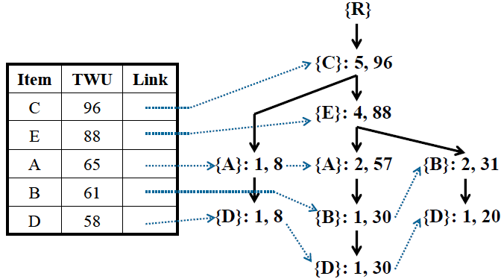
Related Work:
IHUP Algorithm (cont.)
TID | Reorganized Transaction | TU
T₁ | (C,1)(A,1)(D,1) | 8
T₂ | (C,6)(E,2)(A,2) | 27
T₃ | (C,1)(E,1)(A,1)(B,2)(D,6) | 30
T₄ | (C,3)(E,1)(B,4)(D,3) | 20
T₅ | (C,2)(E,1)(B,2) | 11
FP-Growth Algorithm
Generate all the candidates
whose TWUs are no less than min_utility
Construct IHUP Tree
Identify high utility itemsets and their utilities
from the set of candidates
Intelligent DataBase
System Lab, NCKU, Taiwan
Notes:
Let me use a simple example to describe the IHUP algorithm.
IHUP algorithm consists of two phases
In phase 1, it computes the utility for each transaction
For example, the utility of the transaction T1 is 8
then it finds all the items and their TWUs
The TWU of an item is the summation of the utilities of all the transactions which containing the item.
For example, the TWU of item {A} is 65, since item {A} appears in T1, T2 and T3,
Their transaction utilities are 8, 27 and 30, the summation is 65.
Then IHUP algorithm removes the item whose TWU are less than the minimum utility threshold
Since the utility of any its superset must be less than the threshold.
Those itemsets whose TWUs are no less the minimum utility threshold is called HTWUIs
Then, for each transaction, IHUP algorithm sorts the items in a TWU descending order
And removes the unpromising items.
Then IHUP algorithm inserts each transaction into the IHUP Tree, which is a structure similar to FP-Tree
In phase II, it identifies high utility itemsets and their utilities form the set of HTWUIs by scanning
original database once.

Slide 16
Proposed Method:
UP-Growth (Utility Pattern Growth)
Drawbacks of existing approaches
  Generate a huge set of candidates in Phase I and the mining performance is degraded consequently.
  The mining performance becomes worse when database contains lots of long transactions or under low minimum utility threshold.
In this work
  We propose an efficient algorithm called UP-Growth for mining high utility itemsets from databases.
  We develop four effective strategies, DGU, DGN, DLU and DLN, for pruning candidates in phase I.
Intelligent DataBase
System Lab, NCKU, Taiwan

Slide 17
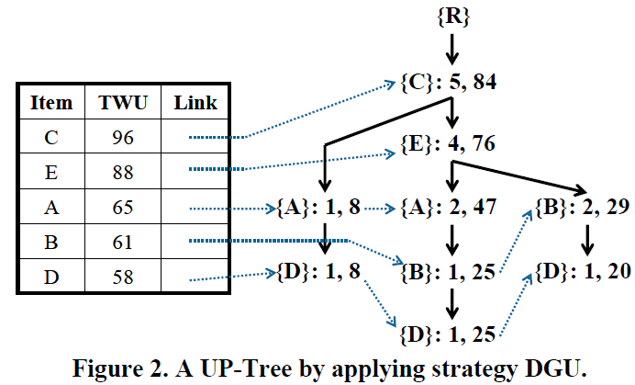
Flow of the proposed method
TID | Transaction | TU
T₁ | (A,1)(C,1)(D,1) | 8
T₂ | (A,2)(C,6)(E,2)(G,5) | 27
T₃ | (A,1)(B,2)(C,1)(D,6)(E,1)(F,5) | 30
T₄ | (B,4)(C,3)(D,3)(E,1) | 20
T₅ | (B,2)(C,2)(E,1)(G,2) | 11
Insert Transactions to construct UP-Tree
Use DGN to reduce the node utilities
min_utility = 40
Items and their TWUs
Item | A | B | C | D | E | F | G
TWU | 65 | 61 | 96 | 58 | 88 | 30 | 38
UP-Growth Algorithm
Construct conditional pattern base by DLU
Construct local UP-Tree by DLN
Reduce TU by DGU
TID | Reorganized Transaction | TU
T₁ | (C,1)(A,1)(D,1) | 8
T₂ | (C,6)(E,2)(A,2) | 22
T₃ | (C,1)(E,1)(A,1)(B,2)(D,6) | 25
T₄ | (C,3)(E,1)(B,4)(D,3) | 20
T₅ | (C,2)(E,1)(B,2) | 9
Generate fewer candidates
Identify high utility itemsets and their utilities
form the set of candidates
Notes:
Then I use this slide to show the flow chart of our algorithm
First, we compute items and their twus
Then we use DGU to reduce the transaction utilities of the transactions
Then we construct our structure by DGN
Our structure is called UP-Tree, our structure is similar to IHUP Tree but
different from IHUP tree,
The node utility of the node in the UP-tree is much less than that in the IHUP-Tree
Since the nodes utilities are effectively reduced by DGN strategy
Then we call UP-Growth algorithm to construct conditional pattern bases and local Up-Trees
Different from FP-Growth algorithm, we construct conditional pattern base by DLU
And construct local up-Tree by DLN strategy
Therefore, the node utility of the node in the local UP-Tree can be further reduced
Thus, our algorithm can generate much fewer candidates than IHUP algorithm in phase I
And achieves a better performance in phase II.

Slide 18
Strategy 1 : DGU
Discarding Global Unpromising items
TID | Transaction | TU
T₁ | (A,1)(C,1)(D,1) | 8
T₂ | (A,2)(C,6)(E,2)(G,5) | 27
T₃ | (A,1)(B,2)(C,1)(D,6)(E,1)(F,5) | 30
T₄ | (B,4)(C,3)(D,3)(E,1) | 20
T₅ | (B,2)(C,2)(E,1)(G,2) | 11
min_utility = 40
Items and their TWUs
Item | A | B | C | D | E | F | G
TWU | 65 | 61 | 96 | 58 | 88 | 30 | 38
TID | Reorganized Transaction | TU
T₁ | (C,1)(A,1)(D,1) | 8
T₂ | (C,6)(E,2)(A,2) | 22
T₃ | (C,1)(E,1)(A,1)(B,2)(D,6) | 25
T₄ | (C,3)(E,1)(B,4)(D,3) | 20
T₅ | (C,2)(E,1)(B,2) | 9
Remove unpromising items and their
utilities form transactions and TUs
Intelligent DataBase
System Lab, NCKU, Taiwan

Slide 19
Strategy 2 : DGN
Discarding Global Node utilities
TID | Reorganized Transaction | TU
T₁ | (C,1)(A,1)(D,1) | 8
T₂ | (C,6)(E,2)(A,2) | 22
T₃ | (C,1)(E,1)(A,1)(B,2)(D,6) | 25
T₄ | (C,3)(E,1)(B,4)(D,3) | 20
T₅ | (C,2)(E,1)(B,2) | 9
{R}
{R}
{C}:1, u(C, T₁)
{C}:1, 1

Slide 20
Strategy 2 : DGN
Discarding Global Node utilities
TID | Reorganized Transaction | TU
T₁ | (C,1)(A,1)(D,1) | 8
T₂ | (C,6)(E,2)(A,2) | 22
T₃ | (C,1)(E,1)(A,1)(B,2)(D,6) | 25
T₄ | (C,3)(E,1)(B,4)(D,3) | 20
T₅ | (C,2)(E,1)(B,2) | 9
{R}
{R}
{C}:1, u(C, T₁)
{C}:1, 1
{A}:1, u(CA, T₁)
{A}:1, 6

Slide 21
Strategy 2 : DGN
Discarding Global Node utilities
TID | Reorganized Transaction | TU
T₁ | (C,1)(A,1)(D,1) | 8
T₂ | (C,6)(E,2)(A,2) | 22
T₃ | (C,1)(E,1)(A,1)(B,2)(D,6) | 25
T₄ | (C,3)(E,1)(B,4)(D,3) | 20
T₅ | (C,2)(E,1)(B,2) | 9
{R}
{R}
{C}:1, u(C, T₁)
{C}:1, 1
{A}:1, u(CA, T₁)
{A}:1, 6
{D}:1, u(CAD, T₁)
{D}:1, 8

Slide 22
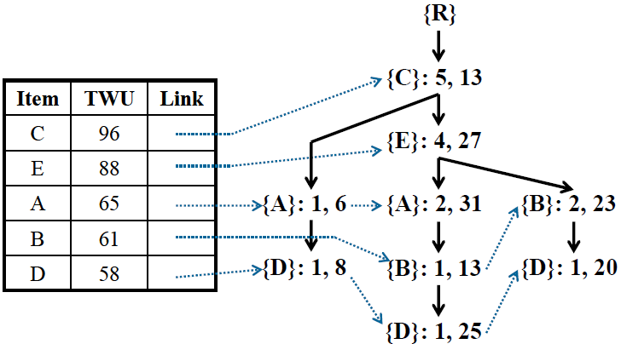
Strategy 2 : DGN
Discarding Global Node utilities
TID | Reorganized Transaction | TU
T₁ | (C,1)(A,1)(D,1) | 8
T₂ | (C,6)(E,2)(A,2) | 22
T₃ | (C,1)(E,1)(A,1)(B,2)(D,6) | 25
T₄ | (C,3)(E,1)(B,4)(D,3) | 20
T₅ | (C,2)(E,1)(B,2) | 9
A global UP-Tree by applying strategies DGU and DGN

Slide 23
Strategy 3 : DLU
Discarding Local Unpromising items
Global UP-Tree
{D}’s conditional pattern base
Path | Support Count | Path utility by Strategies DGU, DGN
{AC} | 1 | 8
{BAEC} | 1 | 25
{BEC} | 1 | 20

Slide 24
Strategy 3 : DLU (cont.)
{D}’s Conditional Pattern Base
Path | Support Count | Path utility by Strategies DGU, DGN
{AC} | 1 | 8
{BAEC} | 1 | 25
{BEC} | 1 | 20
min_utility = 40
Scan {D}’condition pattern base once
Local item | A | B | C | E
Path utility | 33 | 45 | 53 | 45
The path utility of item {A} in the {D}’s conditional pattern is (8+25) = 33.
Hence, {A} is an local unpromising item.
Intelligent DataBase
System Lab, NCKU, Taiwan

Slide 25
Strategy 3 : DLU (cont.)
{D}’s Conditional Pattern Base
Path | Support Count | Path utility by Strategies DGU, DGN
{AC} | 1 | 8
{BAEC} | 1 | 25
{BEC} | 1 | 20
Minimum item utility table
Item | Minimum item utility (MIU)
A | 5
B | 4
C | 1
D | 2
E | 3
Local item | A | B | C | E
Path utility | 33 | 45 | 53 | 45
{D}’s Conditional Pattern Base by applying DGU, DGN and DLU
Path | Support Count | Path utility by Strategies DGU, DGN
{C} | 1 | 3
{CBE} | 1 | 20
{CBE} | 1 | 20
8 – (MIU(A) × SC({AC}))
= 8 – (5 × 1) = 3
Intelligent DataBase
System Lab, NCKU, Taiwan

Slide 26
Strategy 4 : DLN
Discarding Local Node utilities
Minimum item utility table
Item | Minimum item utility (MIU)
A | 5
B | 4
C | 1
D | 2
E | 3
{D}’s Conditional Pattern Base by applying DGU, DGN and DLU
Path | Support Count | Path utility by Strategies DGU, DGN
{C} | 1 | 3
{CBE} | 1 | 20
{CBE} | 1 | 20
{R}
{R}
{C}:1, 20 – (MIU(B) + MIU(E)) × 1
{C}:1, 13
{B}:1, 20 – (MIU(E) × 1)
{B}:1, 17
{E}:1, 20
{E}:1, 20

Slide 27
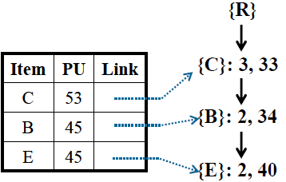
Strategy 4: DLN (cont.)
Local Up-Tree for {D}
{D}’s Conditional Pattern Base by applying DGU, DGN and DLU
Path | Support Count | Path utility by Strategies DGU, DGN
{C} | 1 | 3
{CBE} | 1 | 20
{CBE} | 1 | 20
Intelligent DataBase
System Lab, NCKU, Taiwan

Slide 28
Flow of the proposed method
TID | Transaction | TU
T₁ | (A,1)(C,1)(D,1) | 8
T₂ | (A,2)(C,6)(E,2)(G,5) | 27
T₃ | (A,1)(B,2)(C,1)(D,6)(E,1)(F,5) | 30
T₄ | (B,4)(C,3)(D,3)(E,1) | 20
T₅ | (B,2)(C,2)(E,1)(G,2) | 11
Insert Transactions to construct UP-Tree
Use DGN to reduce the node utilities
min_utility = 40
Items and their TWUs
Item | A | B | C | D | E | F | G
TWU | 65 | 61 | 96 | 58 | 88 | 30 | 38
UP-Growth Algorithm
Construct conditional pattern base by DLU
Construct local UP-Tree by DLN
Reduce TU by DGU
TID | Reorganized Transaction | TU
T₁ | (C,1)(A,1)(D,1) | 8
T₂ | (C,6)(E,2)(A,2) | 22
T₃ | (C,1)(E,1)(A,1)(B,2)(D,6) | 25
T₄ | (C,3)(E,1)(B,4)(D,3) | 20
T₅ | (C,2)(E,1)(B,2) | 9
Generate fewer candidates
Identify high utility itemsets and their utilities
form the set of candidates
Notes:
Then I use this slide to show the flow chart of our algorithm
First, we compute items and their twus
Then we use DGU to reduce the transaction utilities of the transactions
Then we construct our structure by DGN
Our structure is called UP-Tree, our structure is similar to IHUP Tree but
different from IHUP tree,
The node utility of the node in the UP-tree is much less than that in the IHUP-Tree
Since the nodes utilities are effectively reduced by DGN strategy
Then we call UP-Growth algorithm to construct conditional pattern bases and local Up-Trees
Different from FP-Growth algorithm, we construct conditional pattern base by DLU
And construct local up-Tree by DLN strategy
Therefore, the node utility of the node in the local UP-Tree can be further reduced
Thus, our algorithm can generate much fewer candidates than IHUP algorithm in phase I
And achieves a better performance in phase II.

Slide 29
Performance Evaluation
Datasets
  Synthetic dataset
    T10I6D100K
  Real datasets
    Chess
    BMS-Web-View-1
Compared Algorithms
  IHUP + FPG (IHUP)
  UP + FPG
  UP + UPG (UP-Growth)
Platform for Experiment
Intel® Core 2 Quad Processor @ 2.66 GHz
2 Gigabyte Memory
Implement in Java Language
Running on Windows XP
Parameters for IBM Data Generator
D | Number of transactions.
T | Average transaction size.
I | Average maximal potential frequent itemset size.
N | Number of distinct items.
Dataset | N | T | D
T10I6D100K | 1,000 | 10 | 100,000
Chess | 76 | 37 | 3,196
BMS-Web-View-1 | 497 | 2.5 | 59,602

Slide 30
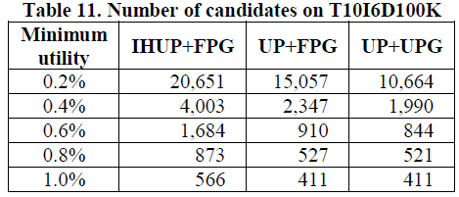
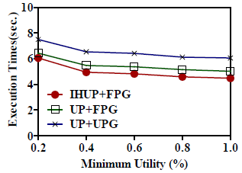
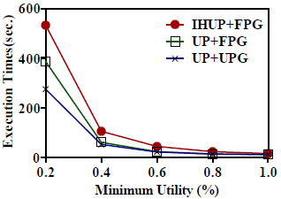
Performance evaluation on
T10I6D100K dataset
Number of Candidates on T10I6D100K
Execution time for Phase I
Execution time for Phase II
Notes:
Since our algorithm perform additional process to reduce node utilities of the nodes

Slide 31
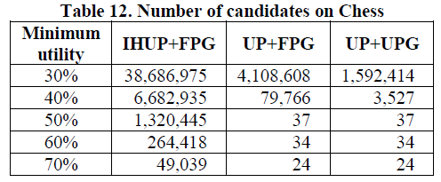
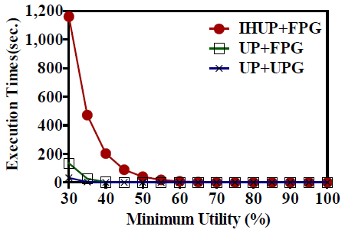

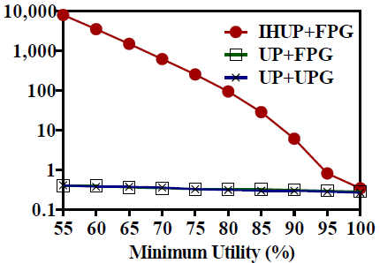
Performance evaluation on
Chess dataset
Number of Candidates on Chess
Execution time for Phase I
Execution time for Phase II

Slide 32
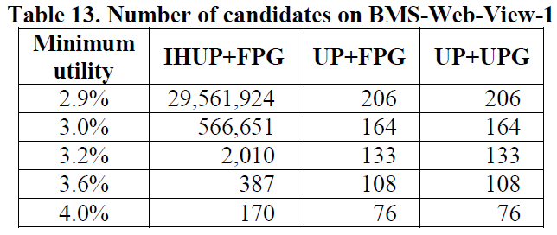
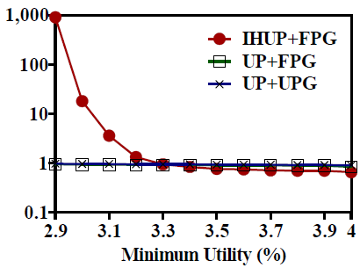
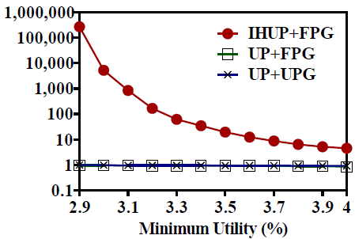
Performance evaluation on
BMS-Web-View-1 dataset
Number of Candidates on BMS-Web_View-1
Execution time for Phase I
Execution time for Phase II

Slide 33
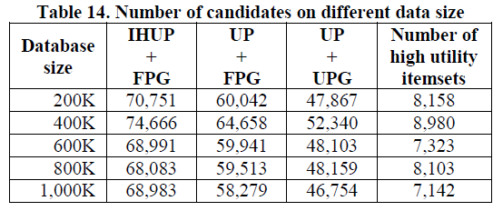
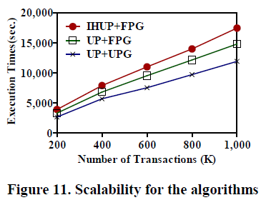
Scalability Evaluation (T10I6 dataset)
Number of Candidates under different database sizes
Scalability for testing algorithms
Intelligent DataBase
System Lab, NCKU, Taiwan

Slide 34
Conclusions
In this paper, we propose an tree-based algorithm, called UP-Growth, for efficiently mining high utility itemsets from databases.
We develop four effective strategies, DGU, DGN, DLU and DLN, to reduce search space and the number of candidates for utility mining.
Experiments show that our UP-Growth outperforms the state-of-the-art algorithm substantially and has a good scalability for large database.
In particular, our UP-Growth is over 10,000 times faster than existing algorithms when database contains lots of long transactions.
Intelligent DataBase
System Lab, NCKU, Taiwan

Slide 35
Thanks for your attention
Vincent S. Tseng : tsengsm@mail.ncku.edu.tw
Cheng-Wei Wu : silvemoonfox@idb.csie.ncku.edu.tw
Bai-En Shie : brian0326@idb.csie.ncku.edu.tw
Philip S. Yu : psyu@cs.uic.edu
Intelligent DataBase
System Lab, NCKU, Taiwan
Notes:
This is the end of my presentation.
Thanks for your attention.
Does anyone have any suggestions?
If you have any question, I'd be pleased to answer them.
I would welcome any comments or suggestions.
Your comments will be highly appreciated.
Excuse me, I didn’t catch the question.
Could you speak the question again slower?
I’m not sure if I answered your question
I hope I answered you the question, but if not, maybe we can discuss more later.

Slide 36
Appendix

Slide 37
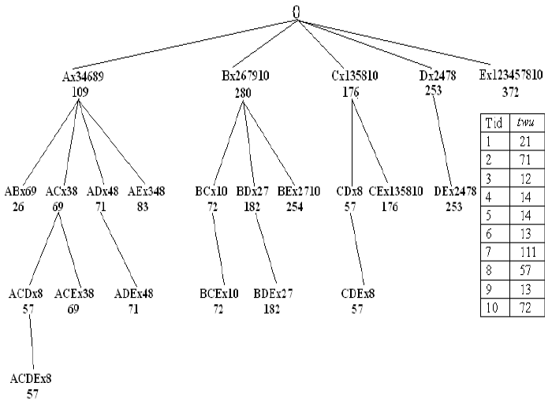
WIT-Tree Algorithm
(ACIIDS 2009)
- <number> -

Slide 38
Several Strategies for Phase II
Strategies
  1. Using tidlist of utility itemsets to compute exact utility
  2. Generate each subsets of the transaction for computing exact utilities
- <number> -

Slide 39
Strategy 1
(Case 1: Database can be fit into Memory)
Suppose the number of candidates is : |N|
 | A | B | C | D | E | TWU
T1 | 0 | 0 | 16 | 0 | 5 | 21
T2 | 0 | 60 | 0 | 6 | 5 | 71
T3 | 6 | 0 | 1 | 0 | 5 | 12
T4 | 3 | 0 | 0 | 6 | 5 | 14
T5 | 0 | 0 | 4 | 0 | 10 | 14
T6 | 3 | 10 | 0 | 0 | 0 | 13
T7 | 0 | 100 | 0 | 6 | 5 | 111
T8 | 9 | 0 | 25 | 18 | 5 | 57
T9 | 3 | 10 | 0 | 0 | 0 | 13
T10 | 0 | 60 | 2 | 0 | 10 | 72
{BE}x 2,7,10
- <number> -

Slide 40
Strategy 1
(Case 1: Database residents in Disk )
Suppose the number of candidates is : |N|
 | A | B | C | D | E | TWU
T1 | 0 | 0 | 16 | 0 | 5 | 21
T2 | 0 | 60 | 0 | 6 | 5 | 71
T3 | 6 | 0 | 1 | 0 | 5 | 12
T4 | 3 | 0 | 0 | 6 | 5 | 14
T5 | 0 | 0 | 4 | 0 | 10 | 14
T6 | 3 | 10 | 0 | 0 | 0 | 13
T7 | 0 | 100 | 0 | 6 | 5 | 111
T8 | 9 | 0 | 25 | 18 | 5 | 57
T9 | 3 | 10 | 0 | 0 | 0 | 13
T10 | 0 | 60 | 2 | 0 | 10 | 72
{BE}
- <number> -

Slide 41
Strategy 2
Suppose the length of transaction is : m
Candidates
{B} {BD} {BE} {BDE} … … {E}
 | A | B | C | D | E | TWU
T1 | 0 | 0 | 16 | 0 | 5 | 21
T2 | 0 | 60 | 0 | 6 | 5 | 71
T3 | 6 | 0 | 1 | 0 | 5 | 12
T4 | 3 | 0 | 0 | 6 | 5 | 14
T5 | 0 | 0 | 4 | 0 | 10 | 14
T6 | 3 | 10 | 0 | 0 | 0 | 13
T7 | 0 | 100 | 0 | 6 | 5 | 111
T8 | 9 | 0 | 25 | 18 | 5 | 57
T9 | 3 | 10 | 0 | 0 | 0 | 13
T10 | 0 | 60 | 2 | 0 | 10 | 72
{A}, {C}, {D}, {E},
{AC}, {AD}, {AE}, {CD}, {CE}
{DE}, {ACD}, {ACE}, {ADE},
{CDE}, {ACDE}
2^{m}
- <number> -

Slide 42
Drawbacks of Phase II
Drawbacks of Phase II
  Strategy 1:
    Case 1: Database can not be fit into memory in general
    Case 2: Scan database for every candidate
  Strategy 2:
    Keep all candidates in the memory
    Suppose that average transaction length in m,
    we need to search candidate set 2^{m} times for each transaction
- <number> -

